Slide 1
UNIT-III
Number Systems and Logic Gates
Mr. Mandar Kakade
E&TC Department PICT, Pune mnkakade@pict.edu

Slide 2
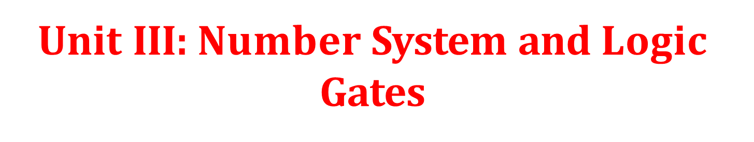
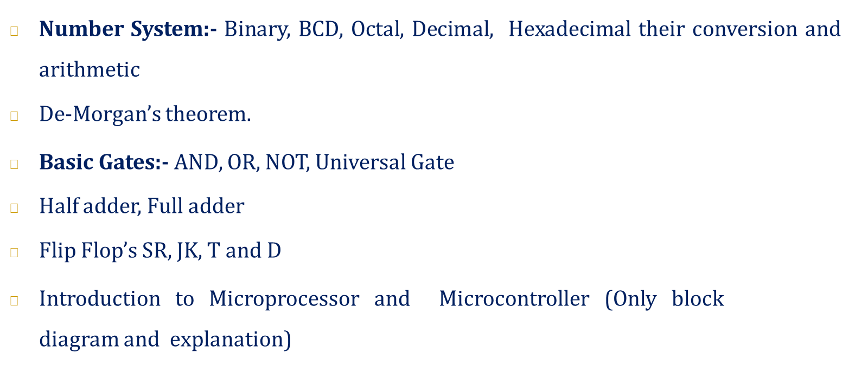

Slide 3
Number Systems
Four number system
▪ | Decimal | (10)
▪ | Binary | (2)
▪ | Octal | (8)
▪ | Hexadecimal |  | (16)

Slide 4
Binary numbers?
Computers work only on two states
On
Off
Basic memory elements hold only two states
Zero / One
Thus a number system with two elements
{0,1}
A binary digit – bit !

Slide 5
Decimal numbers
1439 = 1 x 10³ + 4 x 10² + 3 x 10¹ + 9 x 10⁰
Thousands
Hundreds
Tens
Ones
■ Radix = 10

Slide 6
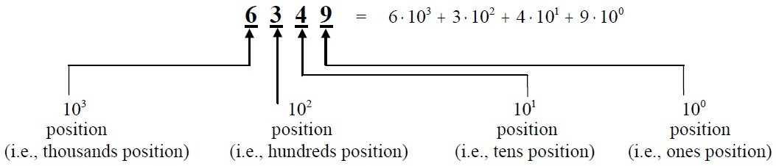
Number System
Decimal
The number system we are familiar with, used every day, is the decimal number system.
Referred to as the base-10 system.
The base-10 system is a positional system
The base-10 number system has 10 distinct symbols, or digits (0, 1, 2, 3,…8, 9).

Slide 7
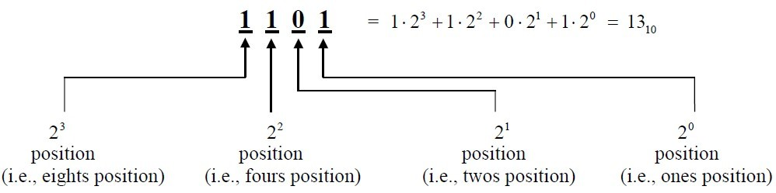
Binary
The point: All data in a computer is represented in binary. A base-2
system, or binary number system.
The term ‘bit’ is a contraction of the words ‘binary’ and ‘digit’, and when talking about binary numbers.
The base-2 system has exactly two symbols: 0 and 1.
0 and 1 are logical values, not the values of a physical quantity.
A string of eight bits (such as 11000110) is termed a byte. A collection of four bits (such as 1011) is smaller than a byte, and is hence termed a nibble.

Slide 8
Converting a Decimal Number to a Binary Number: Method 1
The first method of converting from a decimal number to a binary number entails expressing the decimal number as a sum of powers of 2.
To convert the decimal number x to binary:
Step 1. Find the highest power of two less than or equal to x. The binary representation will have a one in this position. Denote the value of this highest power of 2 as y.
Step 2. Now subtract this power of two (y) from the decimal number (x), denoting the result as z:
■ Z = x - y.
Step 3. If z = 0, you are done. Otherwise, let x = z and return to Step 1 above.

Slide 9
Converting a Decimal Number to a Binary Number: Method 2
The second method of converting a decimal number to a binary number entails repeatedly dividing the decimal number by 2, keeping track of the remainder at each step.
To convert the decimal number x to binary:
Step 1. Divide x by 2 to obtain a quotient and remainder. The remainder will be 0 or 1.
Step 2. If the quotient is zero, you are finished: Proceed to Step
3. Otherwise, go back to Step 1, assigning x to be the value of the most-recent quotient from Step 1.
Step 3. The sequence of remainders forms the binary representation of the number.
This method of repeated division by 2 is called the ‘double- dabble’ method.

Slide 10
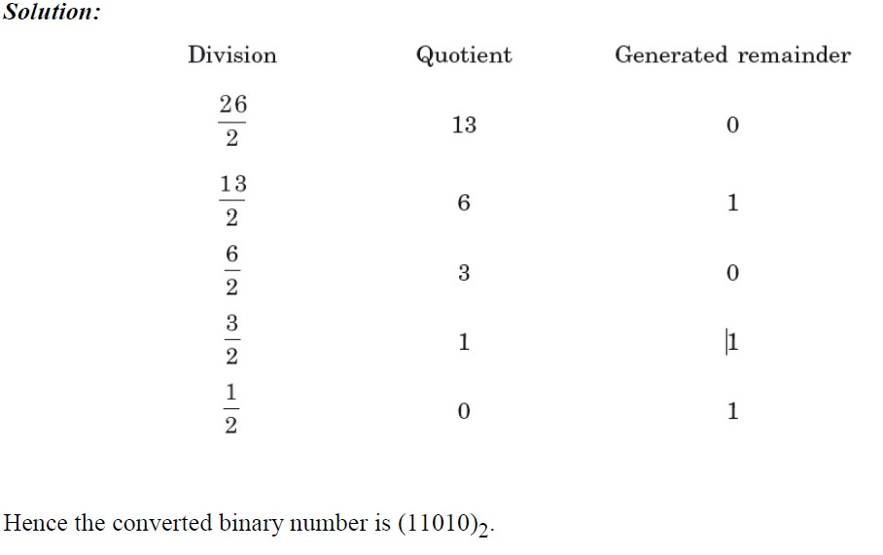
Convert (26)10 into a Binary number.

Slide 11
Binary Decimal
1101 = 1 x 2³ + 1 x 2² + 0 x 2¹ + 1 x 2⁰
= 1 x 8 + 1 x 4 + 0 x 2 + 1 x 1
= 8 + 4 + 0 + 1
(1101)₂ = (13)₁₀
1, 2, 4, 8, 16, 32, 64, 128, 256, 512, ….

Slide 12
Decimal
Binary
2
2
2
2
 | 13
 | 6
 | 3
 | 1
 | 0
LSB
1
0
1
1
MSB
(13)₁₀ = (1101)₂

Slide 13
Octal
■ Octal Numbering System Eight symbols:
❑ 0, 1, 2, 3, 4, 5, 6, 7 •
❑ Notice that we no longer use 8 or 9 Base Comparison: Base 10: 0, 1, 2, 3, 4, 5, 6, 7, 8 , 9, 10,
11, 12…
❑ Base 8: 0, 1, 2, 3, 4, 5, 6, 7, 10 , 11, 12, 13, 14…
Example: What is (15)8 in base 10?
■ (15)8 = ( 1 x 8^1) + ( 5 x 8^ 0) = (13)10
■ Example: What is (7061)8 in base 10?
❑ (7061)8 = ( 7 x 8 ^3) + ( 0 x 8^2) + ( 6 x 8^1) + ( 1 x 8^0)
▪
= 36331

Slide 14
Octal Decimal
137 = 1 x 8² + 3 x 8¹ + 7 x 8⁰
= 1 x 64 + 3 x 8 + 7 x 1
= 64 + 24 + 7
(137)₈ = (95)₁₀
■ Digits used in Octal number system – 0 to 7

Slide 15
Decimal
Octal
8
8
8
 | 95
 | 11
 | 1
 | 0
LSP
7
3
1
MSP
(95)₁₀ = (137)₈

Slide 16
Hexadecimal
The base-16 hexadecimal number system has 16 digits (0, 1, 2, 3, 4, 5, 6, 7, 8, 9, A, B, C, D, E and F).
Converting between binary and hexadecimal is exceedingly easy— much easier than converting between binary and decimal

Slide 17
Converting a Hexadecimal Number to a Decimal Number
Write the hexadecimal number as a sum of powers of 16.
For example, considering the hexadecimal number 1A9B above, we convert this to decimal as:
■ 1A9B = 1 x16³ + Ax16²+ 9x16¹ +Bx16⁰
■
= 4096 + 10(256) + 9(16) + 11(1) =
6811

Slide 18
Hex Decimal
BAD = 11 x 16² + 10 x 16¹ + 13 x 16⁰
= 11 x 256 + 10 x 16 + 13 x 1
= 2816 + 160 + 13
(BAD)₁₆ = (2989)₁₀
A = 10, B = 11, C = 12, D = 13, E = 14, F = 15
20

Slide 19
Decimal Hex
16 2989
13
10
11
LSP
16
186
16 11
0
MSP
(2989)₁₀ = (BAD)₁₆

Slide 20
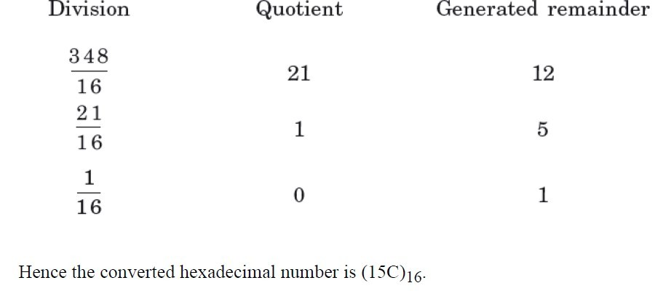
Converting a Decimal Number to a Hexadecimal Number
To convert from decimal to hexadecimal is to use the same division algorithm that you used to convert from decimal to binary, but repeatedly dividing by 16 instead of by 2.
As before, we keep track of the remainders, and the sequence of remainders forms the hexadecimal representation.
❑ Convert (348)10 into a hexadecimal number.

Slide 21
Converting a Hexadecimal Number to a Binary Number
We can convert directly from hexadecimal notation to the equivalent binary representation by using the following procedure:
Convert each hexadecimal digit to a four digit binary number, independent of the other hexadecimal digits.
Concatenate the resulting four-bit binary numbers together.
For example, to convert the hexadecimal number 4DA9 to binary, we first convert each hexadecimal digit to a four-bit string:
■ 4 = 0100 D = 1101 A = 1010 9 = 1001
and then concatenate the results: The resulting binary number is: 0100 1101 1010 1001.
We can drop leading zeros (from the leftmost quartet only!), giving us:
■ 4DA9 = 100110110101001

Slide 22
Converting a Binary Number to a Hexadecimal Number
Convert directly from binary notation to the equivalent hexadecimal
representation by using the following procedure:
Starting at the right, collect the bits in groups of 4
Convert each group of 4 bits into the equivalent hexadecimal digit
Concatenate the resulting hexadecimal digits
For example, to convert 110110101001 to hexadecimal, we collect the bits into groups of 4 starting at the right: 1101 1010 1001, and then we convert each collection of bits into a hexadecimal digit:
❑ 1101 1010 1001
D A 9
❑ Thus 110110101001 = DA9

Slide 23
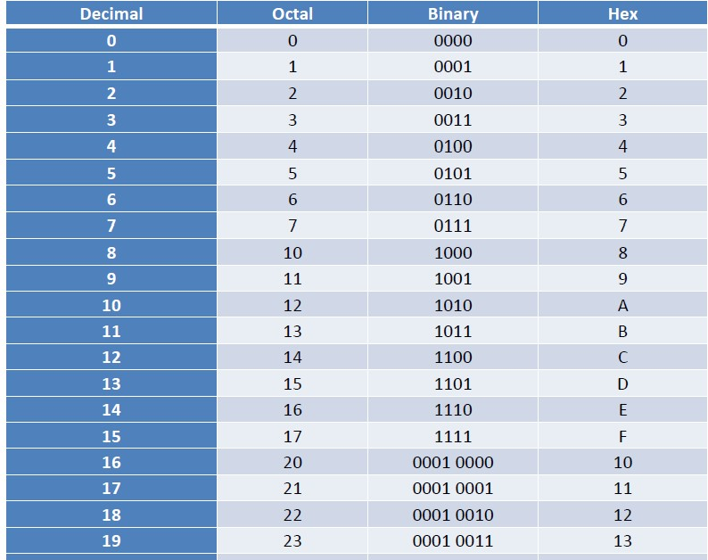
Number Representation

Slide 24
Conversion of Floating Numbers
Binary to Decimal
10111.0101
(1× 2⁴ + 0 × 2³ +1× 2² +1× 2¹ +1× 2⁰ ).(0 × 2⁻¹ +1× 2⁻² +1× 2⁻³ +1× 2⁻⁴ ) (16 + 0 + 4 + 2 +1).(0 + 0.25 + 0.125 + 0.0625)
23.4375

Slide 25
Decimal to Binary
23.4375
23 ⇒ 2 23
Remainder 1 LSB
1
2 11
2 5
2 2
1
1
0
1 MSB (23)₁₀ = (10111)₂
0.4375 ⇒ 0.4375× 2 = 0.875× 2 = 1.75 ⇒ 0.75× 2 = 1.5 ⇒ 0.5× 2 = 1
0 1 1 1
(23.4375)₁₀ = (10111.0111)₂

Slide 26
BCD Binary-Coded Decimal
We close with a brief overview of a different manner of converting between binary and decimal.
In some practical applications we will use a digital logic circuit to drive a numeric display, where each
individual display unit displays a single digit. So, for example, we might have the number 472 in our
logic circuit, and we would like to display this on three separate display units (one for the 4, one for the 7
and one for the 2).
Working with this sort of display hardware is facilitated through the use of binary-coded decimal (BCD),
where each individual digit is represented by a 4-bit number. For example, to represent the decimal
number 472 in binary-coded decimal (BCD), we convert each digit to a four bit binary number,
independent of the other decimal digits. Thus, 472 equal 0100 0111 0010 in BCD.

Slide 27
Why octal or hex?
Ease of use and conversion
Three bits make one octal digit 111 010 110 101
7 2 6 5 => 7265 in octal
Four bits make one hexadecimal digit
1110 1011 0101
E B 5 =>
4 bits = nibble
EB5 in hex

